Slide 1



IUIGA Case Analytics – Is Omni-channel Worth It?
Brock Bennett
Joe Athimala Maria
Rhoda Alawiye
Dr. Yulun Wang
1

Slide 2
Background
IUIGA – Background
A Singapore-based retailer that sells modern home and lifestyle goods via online shop (website, mobile app) and physical stores (pop-up, brick-and-mortar)
Launched online in May 2017; opened first physical store in May 2018
Now operating 9 physical stores (account for 80% of total sales)
Online vs. Physical Stores – Pros and Cons
Online: low cost BUT difficulty in promoting brand & increasing sales
Physical stores: better brand awareness, benefit-to-cost ratio, customer service BUT higher cost & challenges in managing inventory, display, turnover, profit margins

Slide 3
Research Objective & Questions
Research Objective
Is omni-channel worth it? How should the future retail strategy be designed?
Research Questions
(1) Are sales and number of customers different among purchase channels and devices?
(2) How are sales and number of customers changing over the years?
(3) Are physical stores contributing to market growth collaboratively or cannibalizing online sales?
(4) Did the purchase behavior of online customers differ from those who shopped offline?
(5) Are there any associations between purchase channels and devices?

Slide 4
Data and Workflow
Data – 8 variables (columns) w/ 103,315 records (rows)
Transaction ID (number of transactions), Customer ID (number of Customers)
Transaction date (3 July 2017 – 31 Aug 2019)
Days since first purchase (return customers)
Basket size in units and dollars (number of items and dollar amount in a transaction)
Purchase channel (online, pop-up/offline), Device (ios, android, pc, webapp)
Newly created variable(s)
Aggregations in terms of purchasing behavior, slicing time periods, sets for grouping
Workflow
Visualization & Analysis in Tableau, Power BI, JMP → Results and Discussions → Recommendations

Slide 5
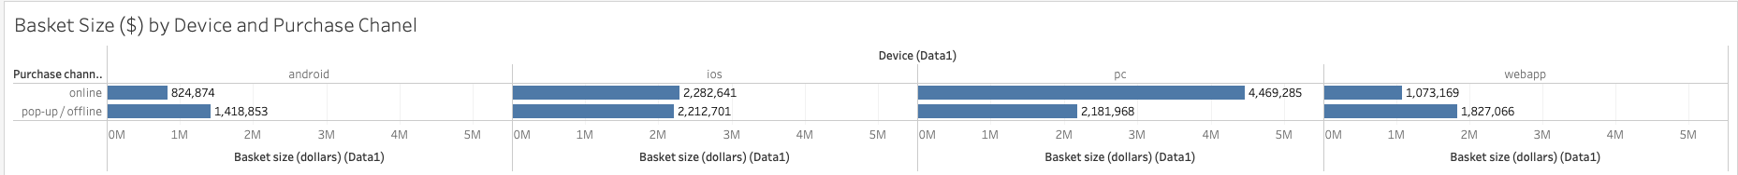
(1.1) Are Sales Different for Purchase Channels and Devices?
5
Notes:
From our findings in this sheet, we may infer that pc sales and ios products produce highest sales from basket size. It is also important to note that their legacy application is ranked the third used product that assists with their sales. They market the use of the application when checking out of the store but the customers do not use the app outside of the offiline/pop up stores.

Slide 6
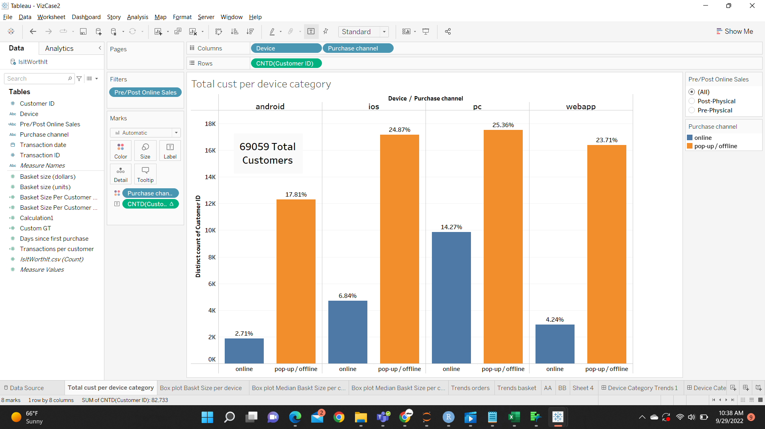
(1.2) Are Customers Different for Purchase Channels and Devices?
Since IUIGA started, the offline segment has clearly dominated in terms of the customer base across all devices.

Slide 7
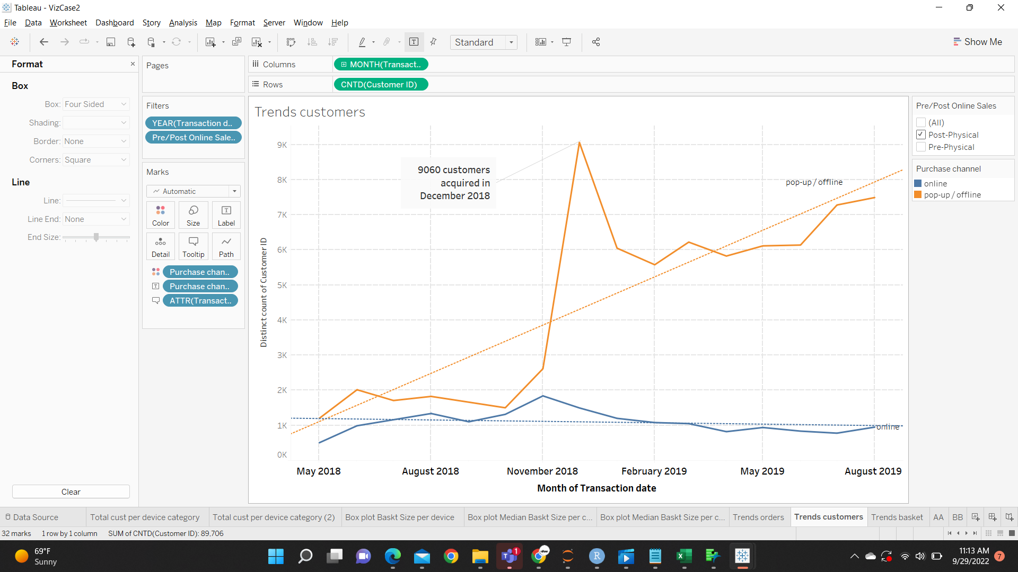
(2.2) How Are Total Customers Changing Over Time?
Pop-ups started : May 2018
Brick and mortar store started : December 2018

Slide 8
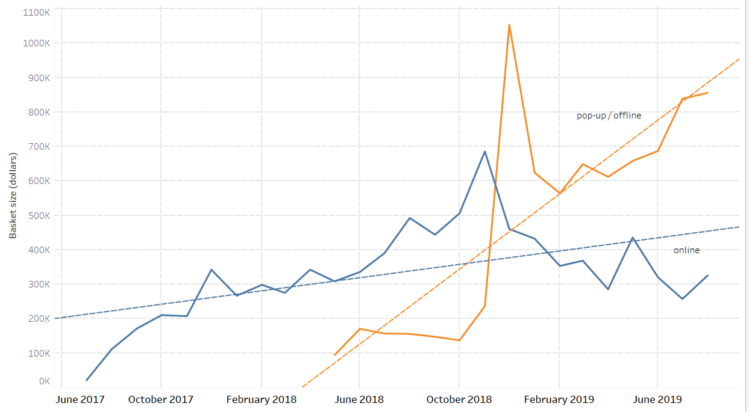
(2.2) How Are Sales Changing Over Time?
Overall basket size (USD) : Grows exponentially for physical channel after Brick and mortar store opens in December 2018.

Slide 9
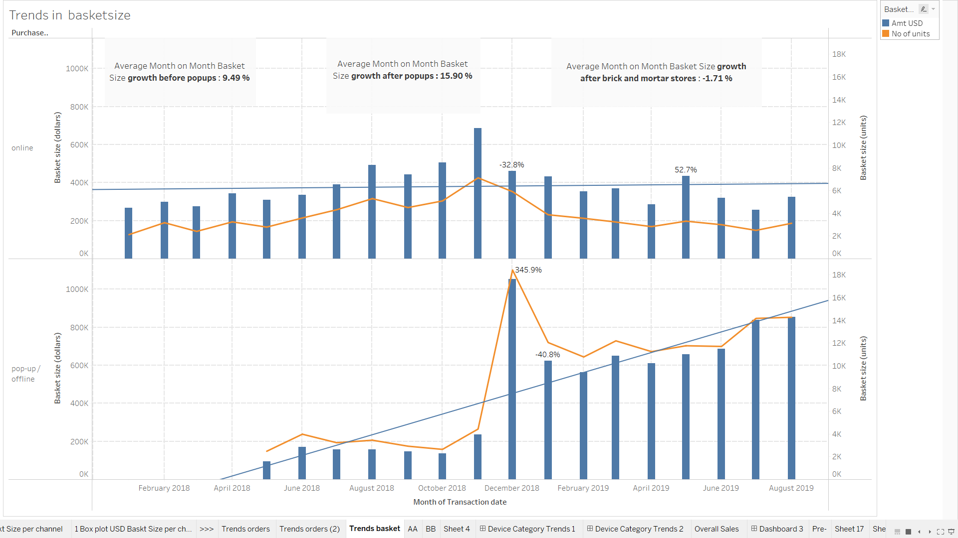
(3) Growth Trends of Online and Offline → Inclusive Or Exclusive?
9

Slide 10
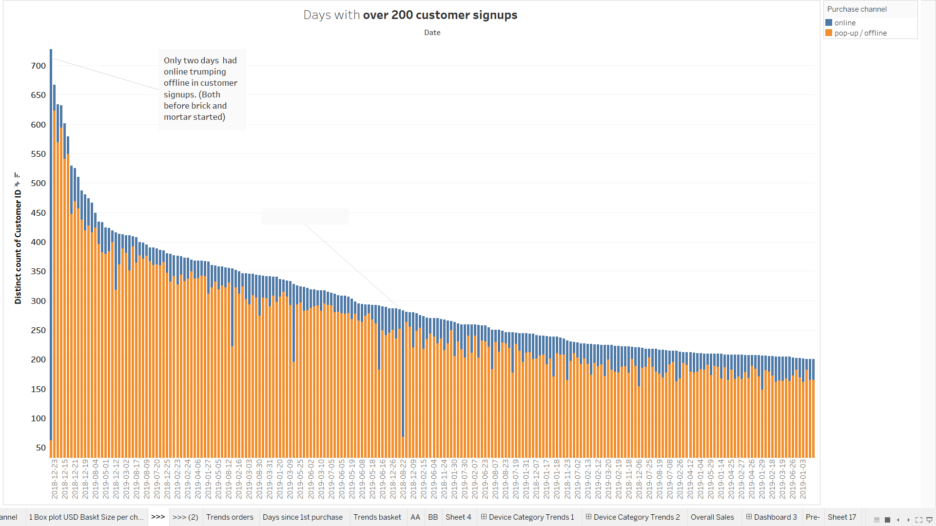
10

Slide 11
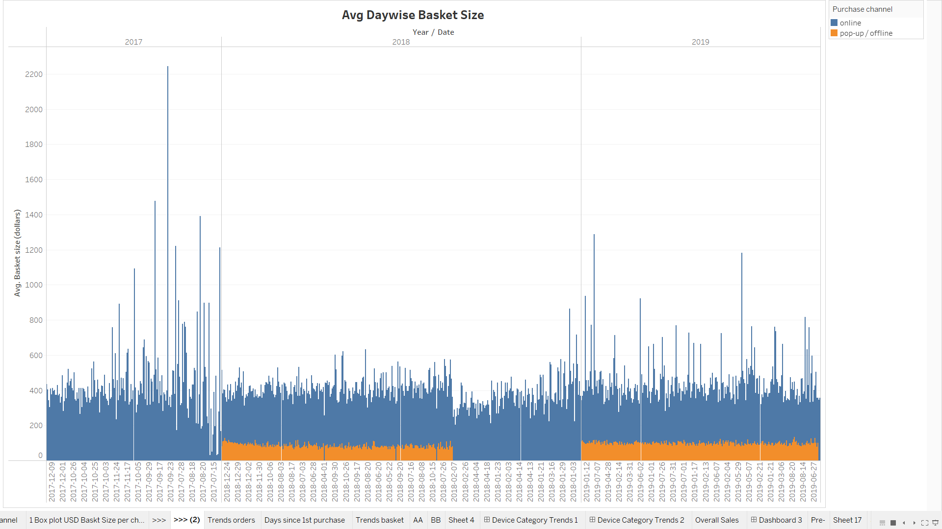
11

Slide 12
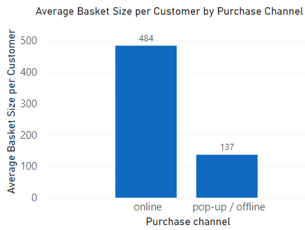
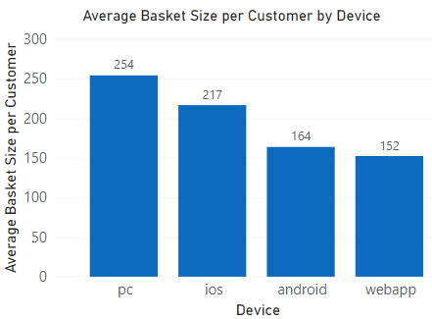
(4) Online vs. Offline Customers – Do Purchasing Behaviors Differ?
Average basket size ($) per Customer vs. Channel & Device:
By Purchase Channel (left): online (484) is distinctively higher than pop-up/offline (137)
By Device (right): highest in PC (254), lowest in webapp (152)
Notes:
In order to evaluate the purchase behaviors of customers, we created a new variable of average basket size in dollar amount per customer.
And from the perspectives of purchase channel and device, we can see that online shows distinctively higher value than offline.
And among different devices, pc shows the highest value, and webapp shows the lowest value.

Slide 13
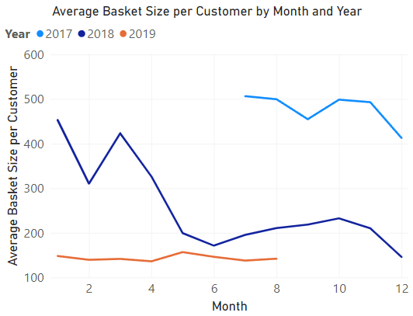
(4) Online vs. Offline Customers – Do Purchasing Behaviors Differ?
Average Basket Size ($) by Time:
2017: flat w/ lowest values
2019: gently declining w/ highest values
2018: declining
Notes:
Throughout the years, average basket size per customer also show different patterns across the three year periods.
In here, it is cross-plotted against months for 2017 in light blue, 2018 in dark blue, and 2019 in orange.
We can see that 2019 shows the overall highest value, followed by 2018 and 2017.
And the data in 2019 stays flat and show an decreasing trend in 2018 and 2017.

Slide 14
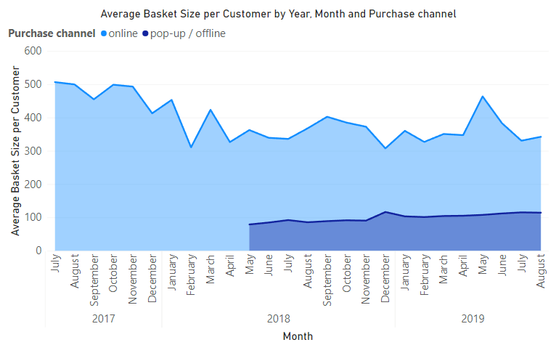
(4) Online vs. Offline Customers – Do Purchasing Behaviors Differ?
By Purchase Channel:
Online w/ higher values at all times
Online was declining until May 2018
Physical stores opened
Since then, online & pop-up/offline were flat
Notes:
And over time, the average basket size per customer also shows different patterns for online and offline customers.
For online in light blue, we can see that it is consistently higher than offline in dark blue.
And for online, it shows an decreasing trend until May 2018, which is when the first physical store was launched.
And since then, both online and offline data stay relatively flat.

Slide 15
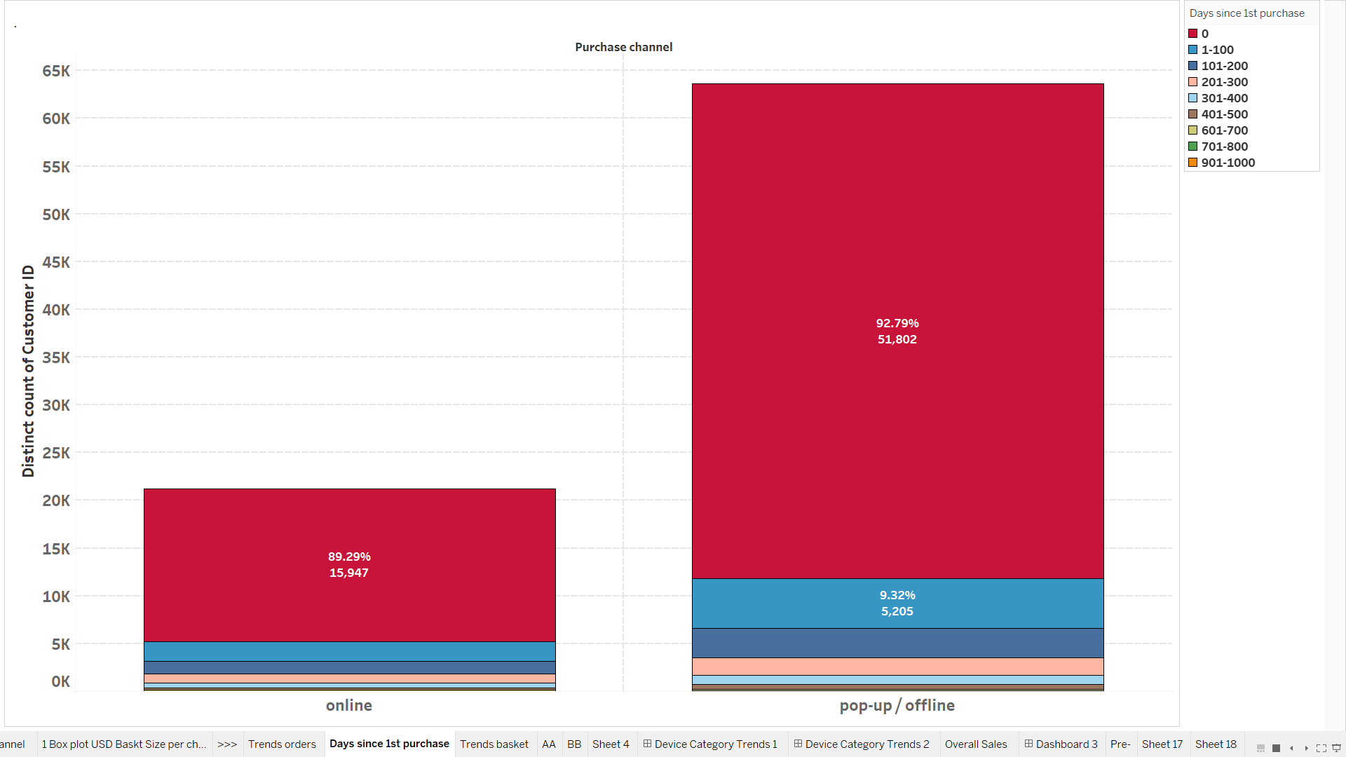
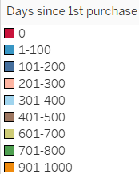
(4) Online vs. Offline Customers – Do Purchasing Behaviors Differ?
vs. Count of Customers by Purchase Channel
Same patterns in count and % in online vs. pop-up/offline
90% of customers first purchase online or offline then never returned
Notes:
And here we took a further look at the data by purchase channel and count customers, and different colors here represent number or ranges of Days Since First Purchase.
In this bar chart, we can see that online and offline have about 90% of customers show 0 days since first purchase, meaning that they made their first purchase either online or offline but never returned.

Slide 16
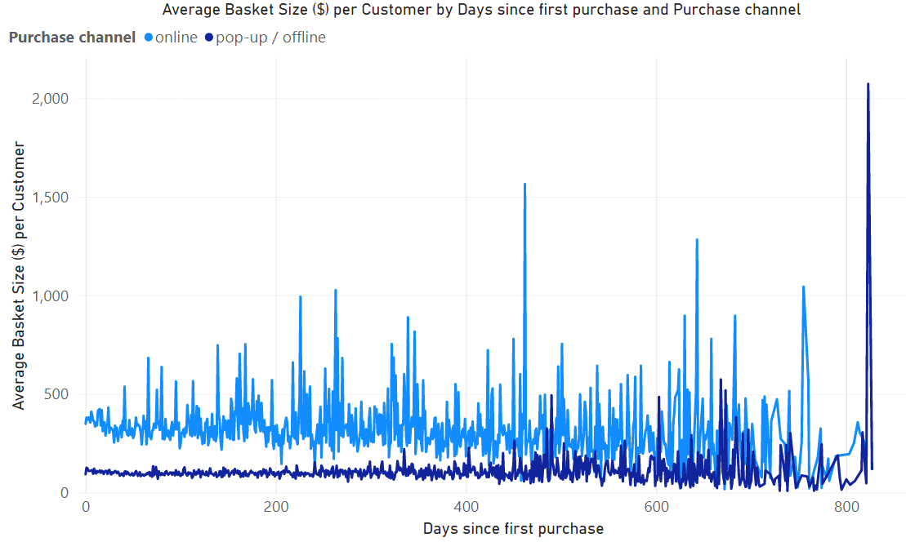
(4) Online vs. Offline Customers – Do Purchasing Behaviors Differ?
vs. Average Basket Size ($) per Customer
Online > pop-up/offline w/ drastic fluctuations
Online: overall decreasing trend; pop-up/offline: flat
Notes:
To gain additional insights, we further integrated the data of “Days Since 1st Purchase”, as shown in this line-plot, in which online data are in light blue, and offline data are in dark blue.
We can see that, for a certain amount of Day since 1st purchase, online customers tend to make distinctively more purchase, but there is a declining trend as the number of days go past about 350.
Although the average basket size show drastic fluctuations, it is evident that the purchase behavior between online and offline customers are different.

Slide 17
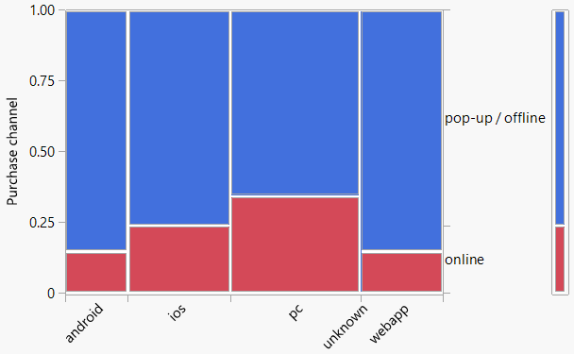
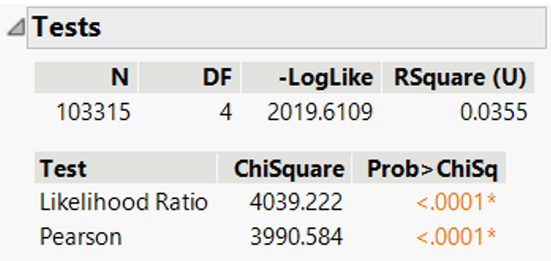
(5) Any Associations Between Purchase Channels and Devices?
17

Slide 18
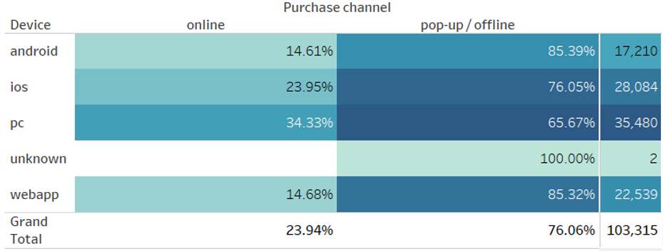
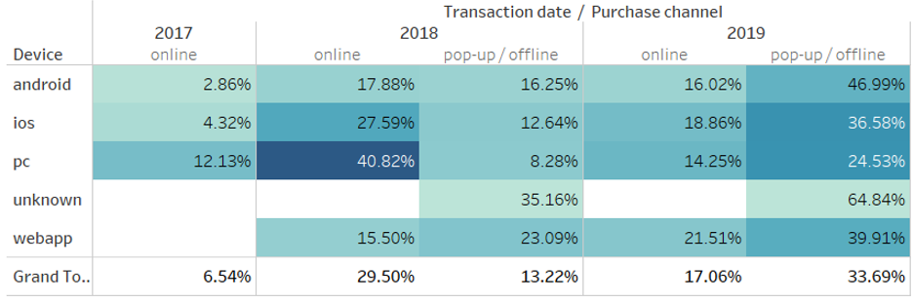
Any Associations Between Purchase Channels and Devices?
18

Slide 19
Take-aways & Recommendations
Take-aways
Omni-channel is here to stay: offline channel brings customers, whereas online channel brings more total/average revenue.
For customer acquisition and sales, offline does affect online, but not so much to cannibalize online
Purchasing behaviors of online and offline customers differ
Recommendations
Future retail strategy be designed by combining online and physical stores
More research for improving offline product portfolio, increase weekend customer acquisition and sales
Synchronize offline and online inventory to enhance customer experience
19

Slide 20
Thank you!
Questions?
Comments?

Slide 21
BACKUP SLIDES

Slide 22
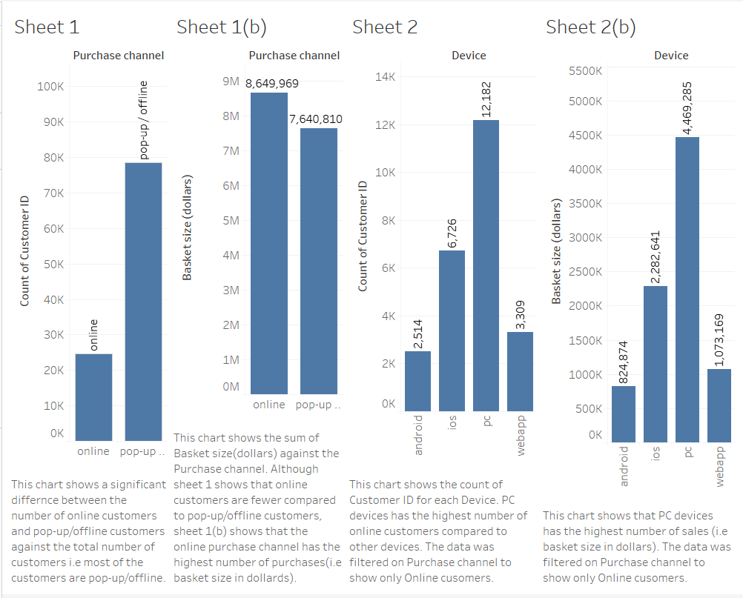
Count of Customer ID per Purchase Channel VS Basket Size($) per Purchase Channel(Online)
Count of Customer ID per Device VS Basket Size($) per Devices

Slide 23
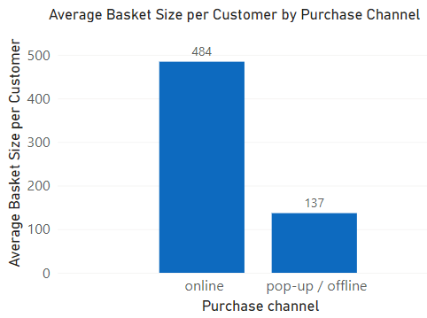
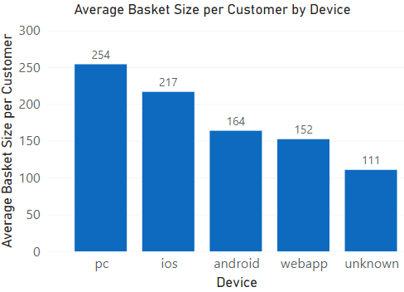
Average Basket Size ($) per Customer vs. Channel & Device

Slide 24
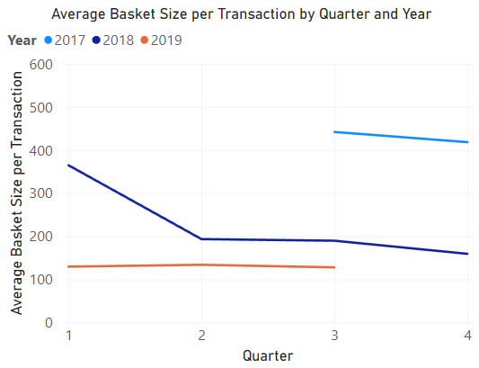
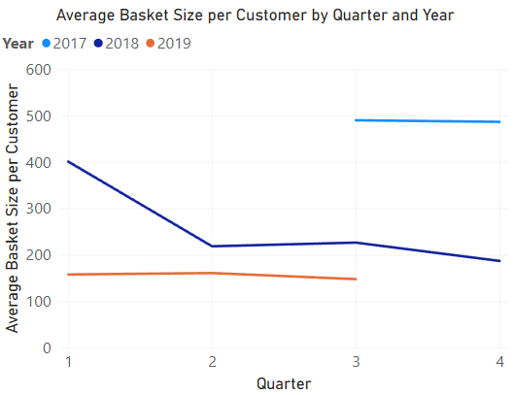
Average Basket Size ($) per Transaction / Customer Over Time

Slide 25
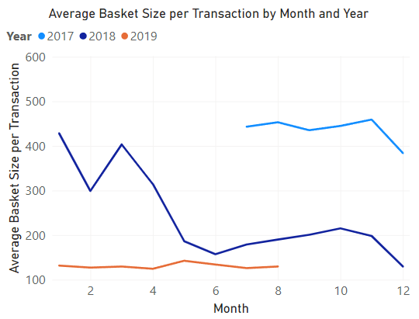
Average Basket Size ($) per Transaction / Customer Over Time
Per Transaction (left): overall flat in 2017 & 2019 (incomplete data); declining trend in 2018
Per Customer (left): similar trends and data range, except for 2017 w/ higher range of values

Slide 26
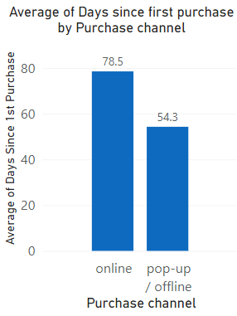
Online vs. Offline Customers – Do Purchasing Behaviors Differ?
Average Days Since 1st Purchase (left): online > pop-up/offline
vs. Average Basket Size ($) per Transaction (right):
Online > pop-up/offline w/ drastic fluctuations
Online: overall decreasing trend; pop-up/offline: flat
Notes:
To evaluate if the behavior of online customers is different from those who shop offline, we analyzed “Days Since 1st Purchase”.
As shown by the bar chart on the left, offline customers tend to wait for shorter times to make a return purchase.
And by integrating the average basket size, we can see on the right that For a certain amount of Day since 1st purchase, online customers tend to make distinctively more purchase, but there is a declining trend as the number of days go past about 350.
Although the average basket size show drastic fluctuations, it is evident that the purchase behavior between online and offline customers are different.
vs. Average Basket Size ($) per Transaction (right):
For a certain Days since 1st purchase: online > pop-up/offline w/ drastic fluctuations
Online: overall decreasing trend; pop-up/offline: flat; greater fluctuations as “Days” exceeds 450

